Slide 1
Simple past tense
Sixth English Class – First Grade

Slide 2
What is Simple Past Tense?
Simple past is a verb tense that is used to talk about things that happened or existed before now.
Imagine someone asks about what you did yesterday.
How would you answer?

Slide 4
Can I say…?
I get up at 8.
I brush my teeth.
I have breakfast.
I watch TV.
I play with my phone.
I do my homework.
I have lunch.
Etcetera.

Slide 5
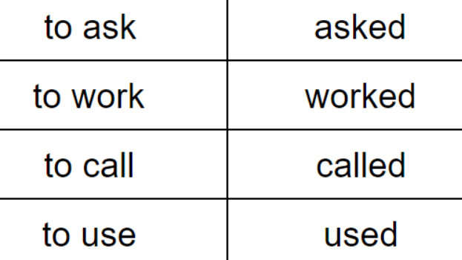
How to build simple past.
It will depend on whether the verbs are regular or irregular.
For regular verbs, add ed to the verb or just d if the verb already ends in an e.

Slide 6
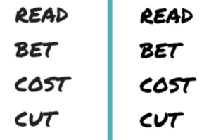
How to build simple past.
For irregular verbs, things get complicated. Some irregular verbs stay the same.

Slide 7
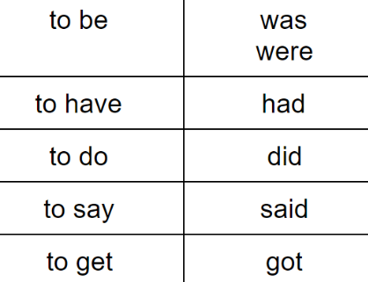
How to build simple past.
Some other verbs (most of them) including the verb to be have totally different forms that we need to learn.

Slide 8
Some regular verbs in past.
Regular verbs just need ed or d:
Need – Needed
Work – Worked
Like – Liked
Love – Loved
Hate – Hated
Live – Lived
Listen – Listened
Complete – Completed
Change – Changed
Walk – Walked
Study – Studied (change the y for i)
Brush – Brushed
Start – Started
Play – Played
Finish – Finished
Watch – Watched

Slide 9
Some irregular verbs in past.
Irregular verbs change in every case.
Be – Was/Were
See – Saw
Eat – Ate
Go – Went
Have – Had
Do – Did
Write – Wrote
Make – Made
Read – Read
Run – Ran
Get – Got
Sleep – Slept
Drink – Drank
Take - Took
Put - Put
Say – Said

Slide 10
Exercise
1. Make 5 sentences using regular verbs in past.
2. Make 5 sentences using irregular verbs in past.

